Slide 1
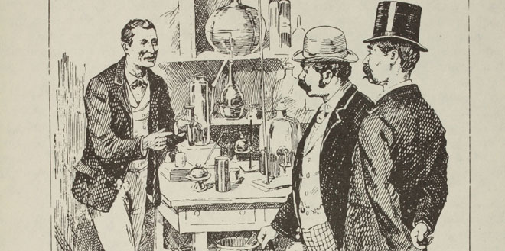
Sherlock Holmes – Forensics Pioneer by Thomas A. Burns, Jr.
Five Miles from Anywhere, 3 June, 2023

Slide 2
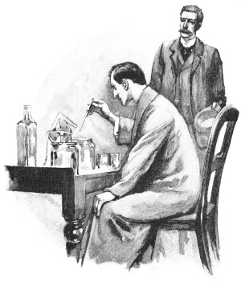
A Man of Science
SHERLOCK HOLMES - his limits
Knowledge of Literature. - Nil.
Knowledge of Philosophy. - Nil.
Knowledge of Astronomy. - Nil.
Knowledge of Politics. - Feeble.
Knowledge of Botany. - Variable. Well up in belladonna, opium, and poisons generally. Knows nothing of practical gardening.
Knowledge of Geology: Practical, but limited. Tells at a glance different soils from each other. After walks has shown me splashes upon his trousers, and told me by their colour and consistence in what part of London he had received them.
Knowledge of Chemistry. - Profound.
Knowledge of Anatomy. - Accurate, but unsystematic.
Knowledge of Sensational Literature. - Immense. He appears to know every detail of every horror perpetrated in the century.
Plays the violin well.
Is an expert singlestick player, boxer, and swordsman.
Has a good practical knowledge of British law.

Slide 3
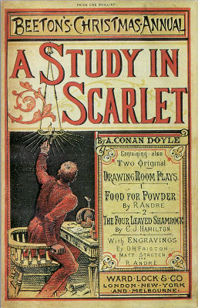
We first meet Holmes in a laboratory
Has developed a new test for blood that will revolutionize forensics
‘Had this test been invented, there are hundreds of men now walking the earth who would long ago have paid the penalty of their crimes… Now we have the Sherlock Holmes test, and there will no longer be any difficulty.’
‘…I dabble with poisons a good deal.'

Slide 4
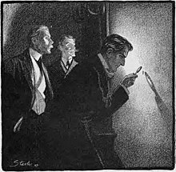
Other Instances of Forensics in the Canon
Fingerprints
  The Sign of the Four (1890)
    ‘Man's thumbmark on corner - probably postman.’
  The Adventure of the Norwood Builder (1903)
    ‘It was the well-marked print of a thumb.’
  The Three Gables (1926)
    ‘There is always the chance of finger-marks or something.’

Slide 5
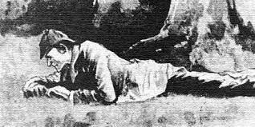
Other Instances of Forensics in the Canon(cont.)
Footprints
  Footprints first mentioned in A Study in Scarlet.
  Footprint evidence is important in 29 of 60 stories
  The Boscombe Valley Mystery is solved almost entirely by footprint analysis

Slide 6
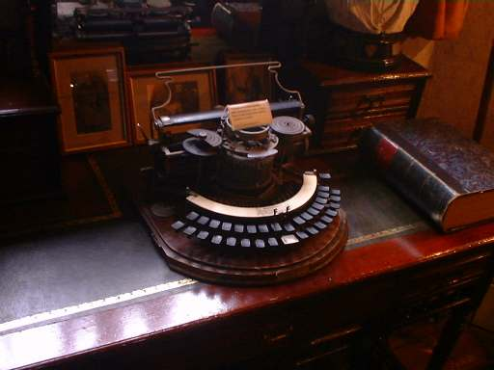
Other Instances of Forensics in the Canon (cont.)
Typewriter analysis
  A Case of Identity
    'It is a curious thing,' remarked Holmes, 'that a typewriter has really quite as much individuality as a man's handwriting. Unless they are quite new, no two of them write exactly alike. Some letters get more worn than others, and some wear only on one side. Now, you remark in this note of yours, Mr Windibank, that in every case there is some little slurring over of the "e", and a slight defect in the tail of the "r". There are fourteen other characteristics, but those are the more obvious.'

Slide 7
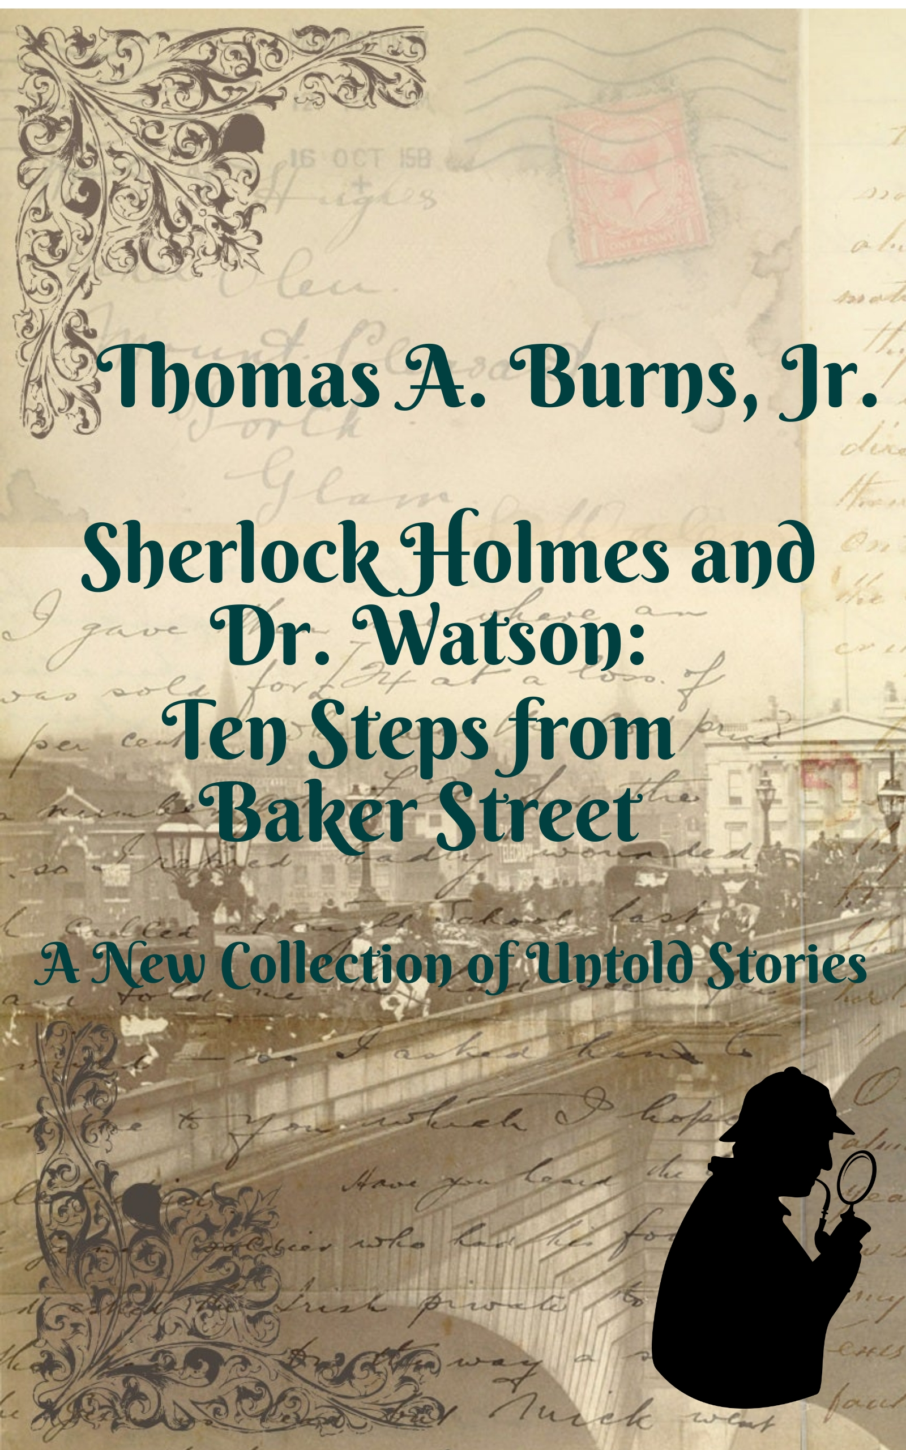
My New Sherlock Holmes Collection
Published March 1, 2023
Ten new stories
In some of them, I continue ACD’s tradition of portraying Holmes as a pioneer of forensic methods

Slide 8
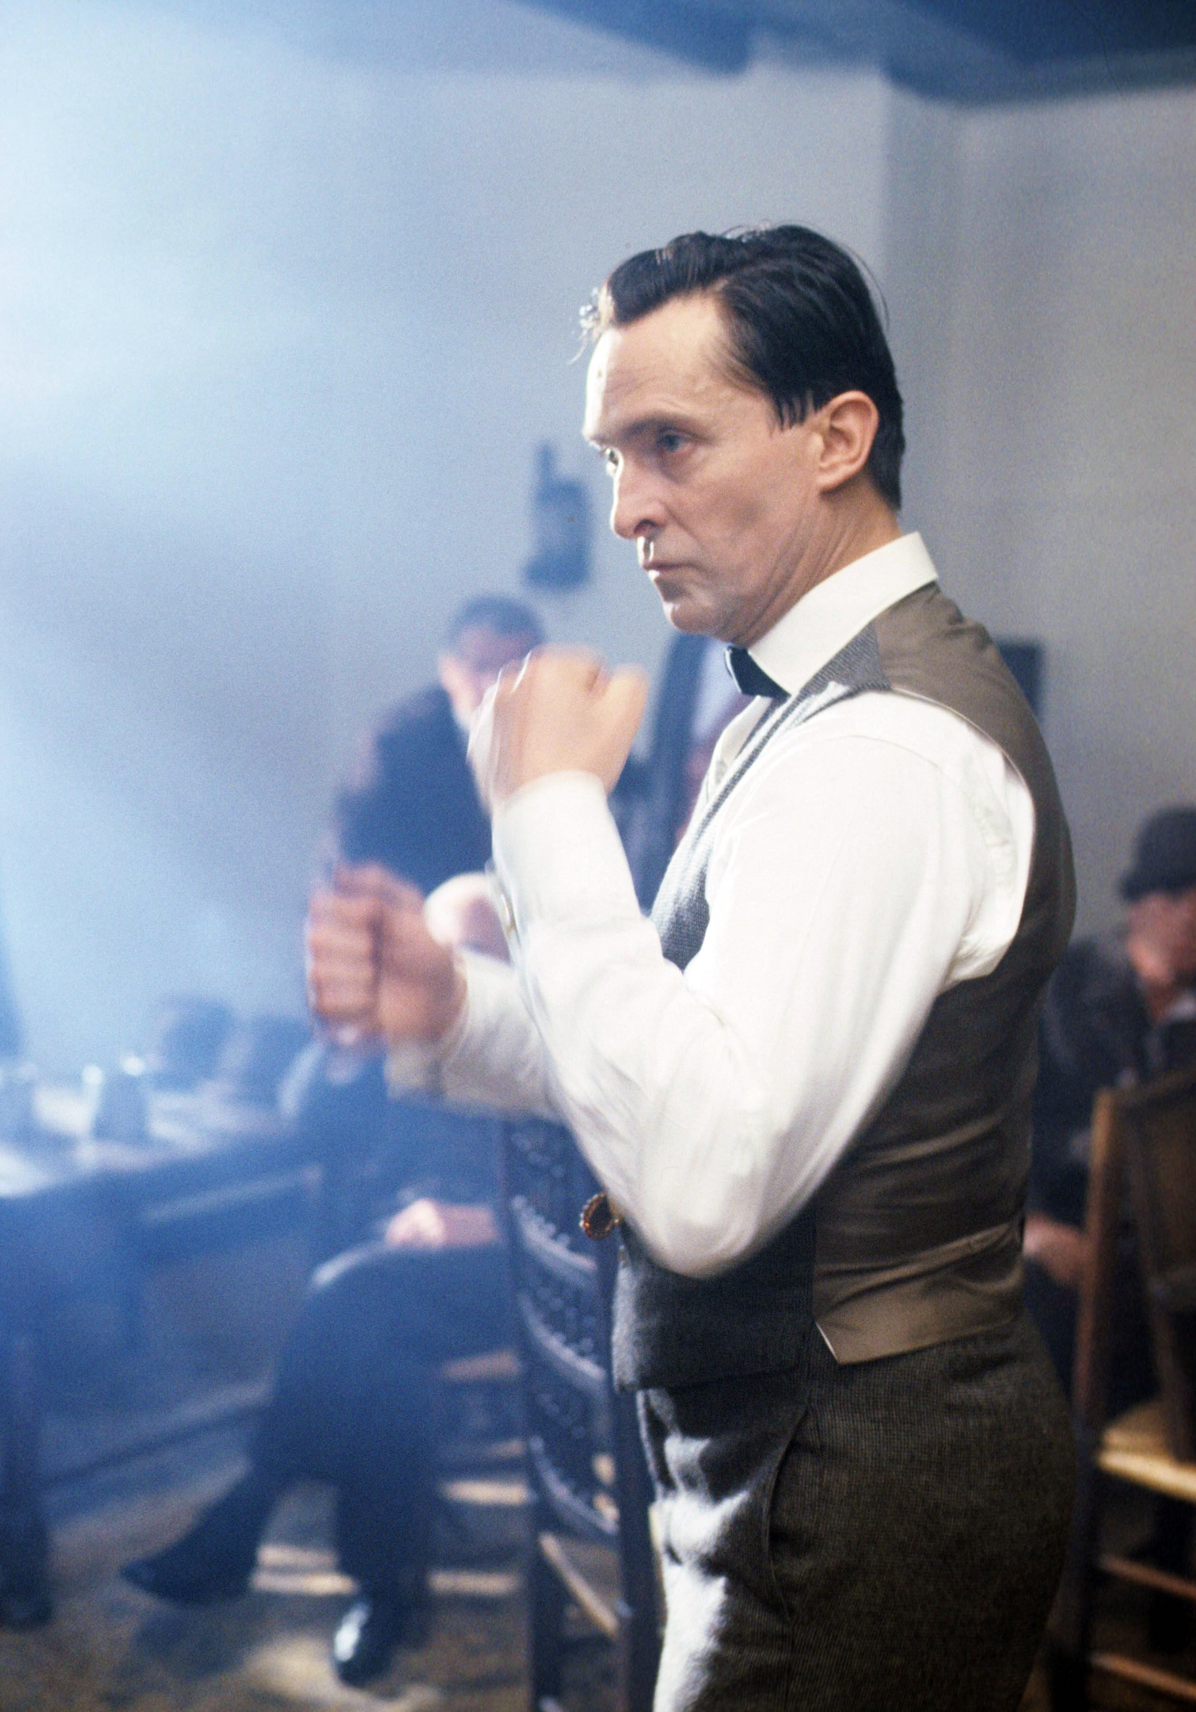
10 Steps: The Adventure of the Persistent Pugilist
Occurs just after STUD - the second time Watson assists Holmes.
Holmes investigates the beating death of a nobleman in the street.
Uses footprint analysis to determine the sequence of events, and who was at the scene.

Slide 9
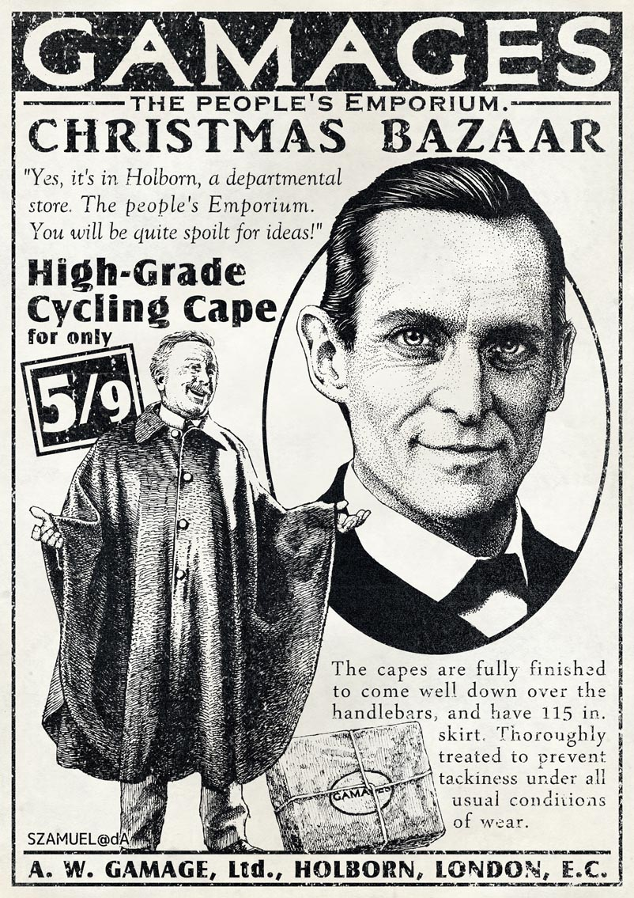
10 Steps: Christmas at the Red Lion
Holmes and Watson investigate a poison pen case
Holmes uses typewriter analysis to identify the perpetrator

Slide 10
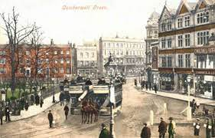
10 Steps: The Camberwell Poisoner
First appeared in The Strand Magazine March-June 2021
Holmes investigates a series of random poisonings across London
Showcases his chemistry skills
Holmes invents geographic profiling to track down the poisoner
Also employs handwriting analysis to predict the miscreant’s personality traits

Slide 11
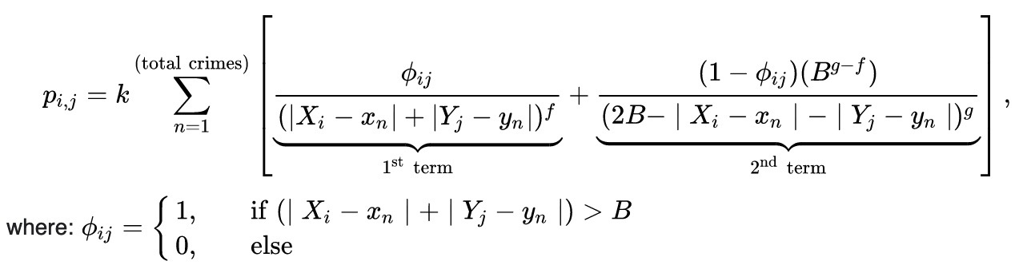
Geographic Profiling
A probabilistic method to determine the location of an offender.
Analyzes the geographic coordinates of connected crimes, allowing the production of a map showing probabilities of the most likely areas of an offender's home base.
Detailed 1:1056 maps of London produced by the Ordinance Survey comprising 759 sheets were brought out between 1891 and 1895.
“I had an excellent maths tutor…”

Slide 12
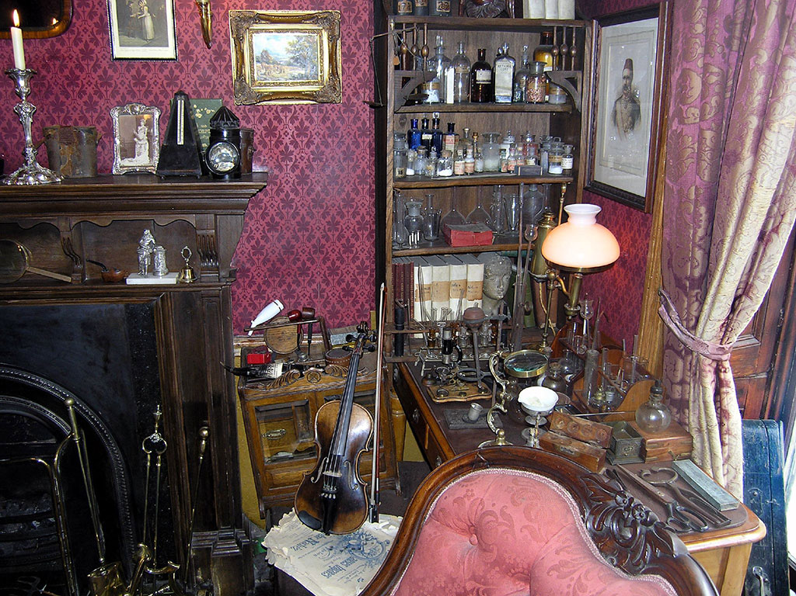
10 Steps: Another Case of Identity
Another adventure that highlights Holmes as a chemist.
According to Watson, this is Holmes’s greatest area of scientific expertise
“Well up in belladonna, opium and poisons generally…”

Slide 13
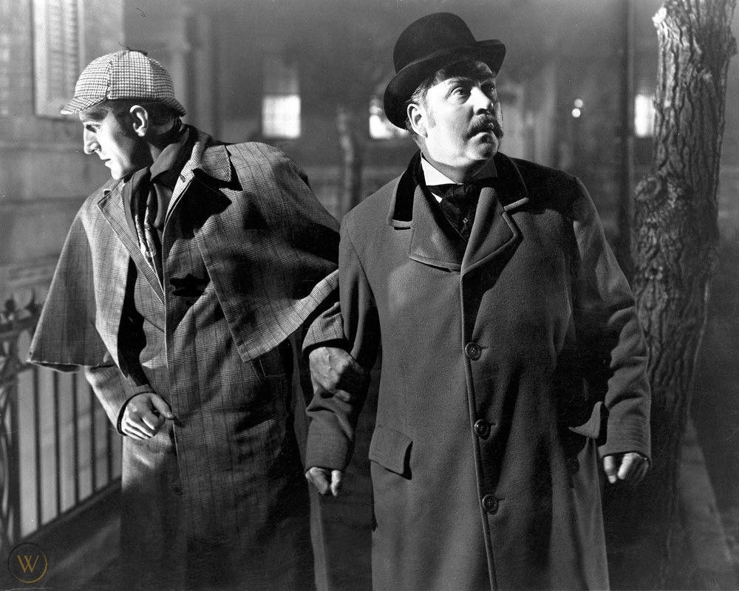
10 Steps: The Horror in King Street
Holmes and Watson investigate the disappearance of a costermonger.
Holmes uses forensic composite drawing to produce a sketch of a person of interest.
Identifies a murder weapon by wound characteristics

Slide 14
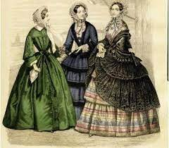
10 Steps: The Witch of Ellenby
Holmes travels to the Cumberland Lake District to investigate a case of contemporary witchcraft.
Another adventure that displays Holmes’s knowledge of chemistry and toxicology.

Slide 15
Available in Paperback and as an E-book on Multiple Platforms
Apple Books
Amazon (paperback)
Baker & Taylor
Barnes and Noble
Bibliotheca
Borrow Box
Hoopla
Overdrive
Palace Marketplace
Rakuten Kobo
ScribD
Smashwords
Tolino

Slide 16

I’ll leave you with this…

